Slide 1
Servlet

Slide 2

Topics
Basics of Operating Systems
Network Basics
Software Engineering Basics

Slide 3
The Hypertext Transfer Protocol (HTTP)
A request and response protocol. The client requests a file and the server responds to the request.
It's always the client who initiates a transaction by establishing a connection and sendingan HTTP request.
The server is in no position to contact a client or make a callback connection to the client.
Either the client or the server can prematurely terminate a connection.

Slide 4
HTTP Requests
An HTTP request consists of three components:
  Method——URI—Protocol/Version
  Request headers
  Entity body
POST /servlet/default.jsp HTTP/1.1
User-Agent: Mozilla/4.0 (compatible; MSIE 4.0; Windows 98)
Accept: image/gif, image/jpeg, text/*, */*
Content-Length: 33
LastName=Franks&FirstName=Michael

Slide 5
HTTP request Methods
the GET method is designed for getting information; information is passed as a sequence of characters appended to the request URL in what's called a query string.
the POST method is designed for posting information; POST is used to transfer a block of data to the server in the entity body of the request.

Slide 6
HTTP Responses
an HTTP response also consists of three parts:
  Protocol—Status code——Description
  Response headers
  Entity body
HTTP/1.1 200 OK
Server: Microsoft-IIS/4.0
Date: Mon, 3 Jan 1998 13:13:33 GMT
Content-Type: text/html
Last-Modified: Mon, 11 Jan 1998 13:23:42 GMT
Content-Length: 112
<HTML>
<HEAD>
<TITLE>HTTP Response Example</TITLE></HEAD><BODY>
Welcome to Brainy Software
</BODY>
</HTML>

Slide 7
The Benefits of Servlets
Performance
Portability
Rapid development cycle
Robustness
Widespread acceptance

Slide 8


Servlet Application Architecture

Slide 9
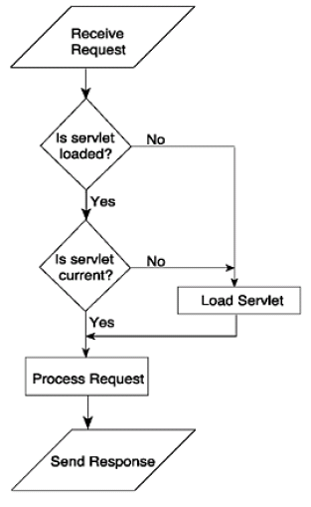
How a Servlet Works

Slide 10
The Servlet API
Servlets use classes and interfaces from two packages:
  javax.servlet : contains classes to support generic, protocol-independent servlets
  javax.servlet.http: extend the classes in the javax.servlet package to add HTTP-specific functionality.
Every servlet must implement the javax.servlet.Servlet interface, Most servlets implement it by extending
  javax.servlet.GenericServlet
  javax.servlet.http.HttpServlet
a servlet does not have a main() method. Instead, each time the server dispatches a request to a servlet, it invokes the servlet's service() method.

Slide 11
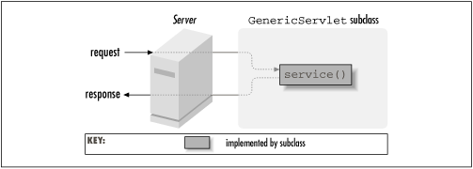
service() method
A generic servlet should override its service() method to handle requests as appropriate for the servlet. The service() method accepts two parameters: a request object and a response object

Slide 12
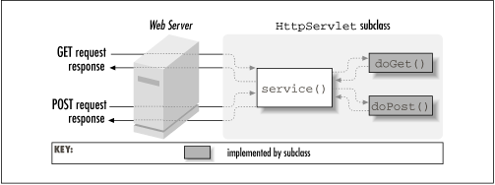
doGet() and doPost()
In contrast, an HTTP servlet usually does not override the service() method. Instead, it overrides doGet() to handle GET requests and doPost() to handle POST requests.

Slide 13
Six Steps to Running Servlet
Create a directory structure under Tomcat for your application.
Write the servlet source code. You need to import the javax.servlet package and the javax.servlet.http package in your source file.
Compile your source code.
Create a deployment descriptor.
Run Tomcat.
Call your servlet from a web browser.
example: Hellow.html, Hello.java

Slide 14
The Servlet Life Cycle
The life cycle of a servlet is determined by three methods of javax.servlet.Servlet interface : init, service, and destroy.
public void init(ServletConfig config) throws ServletException
  The init method is called by the servlet container after the servlet class has been instantiated.
public void service(ServletRequest request, ServletResponse response) throws ServletException, java.io.IOException
public void destroy()
  The servlet container calls the destroy method before removing a servlet instance from service. This normally happens when the servlet container is shut down or the servlet container needs some free memory.

Slide 15
Instance of Servlet
At the time the code for a servlet is loaded, the server creates a single class instance. That single instance handles every request made of the servlet.
  It keeps the memory footprint small
  It eliminates the object creation overhead
  It enables persistence.
  example: SimpleCounter.java
Each registered name for a servlet (but not each alias) is associated with one instance of the servlet.
  example: HolisticCounter.java

Slide 16
Session Management
Anything that makes the application remember information that has been entered or requested by the user can be considered session management.
  When the user requests a servlet, in addition to sending the response, the servlet also sends a token or an identifier.
  If the user come back, the token or identifier is sent back to the server. Upon encountering the token, the next servlet should recognize the identifier and can do a certain action based on the token. When the servlet responds to the request, it also sends the same or a different token.
  example: SessionLoginServlet.java, Content2Servlet.java

Slide 17
